Slide 1

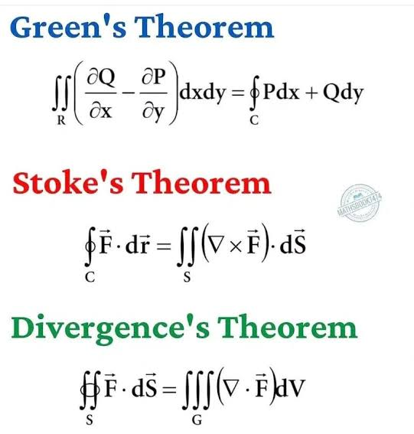
Unit 7
Green’s, Stoke’s and Divergence’s Theorem

Slide 2
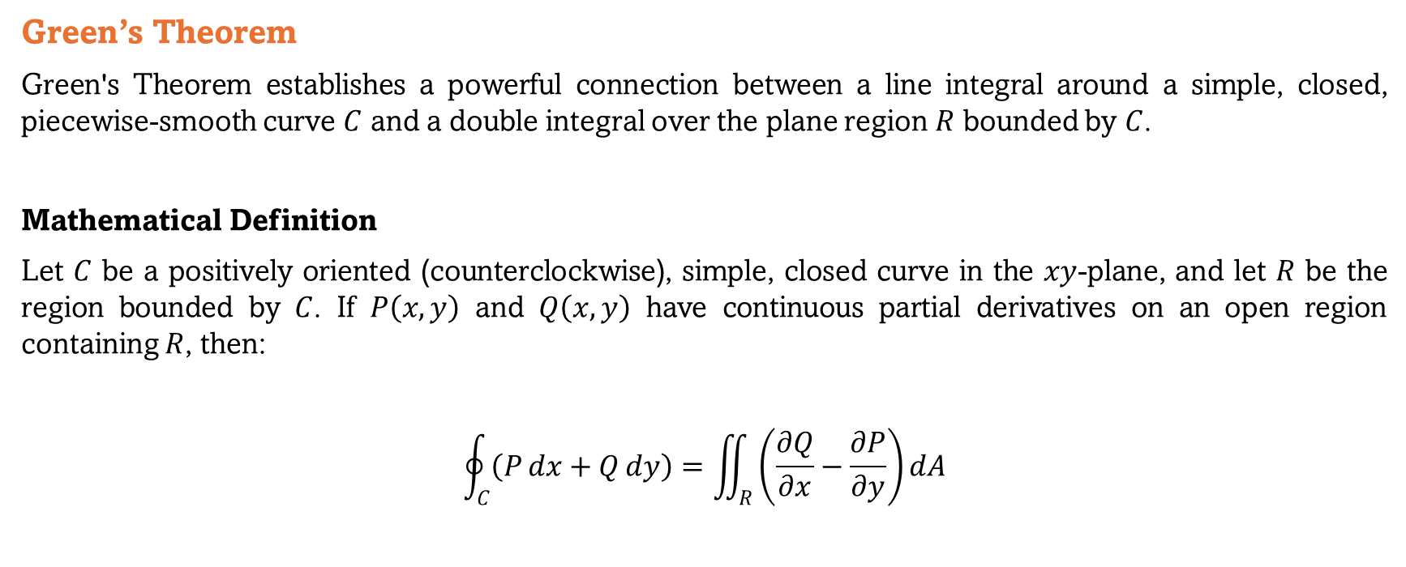
Green’s Theorem
Green's Theorem establishes a powerful connection between a line integral around a simple, closed, piecewise-smooth curve $C$ and a double integral over the plane region $R$ bounded by $C$.
Mathematical Definition
Let $C$ be a positively oriented (counterclockwise), simple, closed curve in the $xy$-plane, and let $R$ be the region bounded by $C$. If $P\left(x,y\right)$ and $Q\left(x,y\right)$ have continuous partial derivatives on an open region containing $R$, then:
$$\oint_{C}{\left(P dx+Q dy\right)}=\iint_{R}{\left(\frac{∂Q}{∂x}−\frac{∂P}{∂y}\right)}dA$$

Slide 3
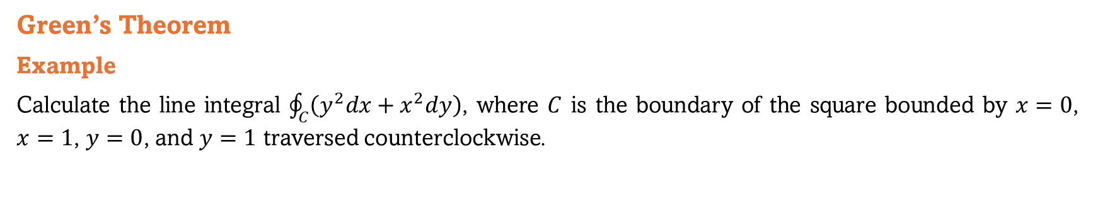
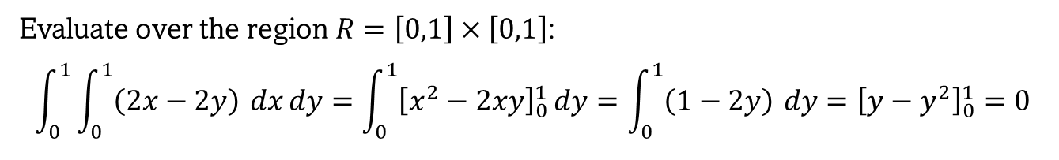
Green’s Theorem
Example
Calculate the line integral $\oint_{C}{\left(y^{2}dx+x^{2}dy\right)}$, where $C$ is the boundary of the square bounded by $x=0$, $x=1$, $y=0$, and $y=1$ traversed counterclockwise.
Evaluate over the region $R=\left[0,1\right]×\left[0,1\right]$:
$$\int_{0}^{1}{\int_{0}^{1}{\left(2x−2y\right)}} dx dy=\int_{0}^{1}{{\left[x^{2}−2xy\right]}_{0}^{1}}dy=\int_{0}^{1}{\left(1−2y\right)} dy={\left[y−y^{2}\right]}_{0}^{1}=0$$

Slide 4
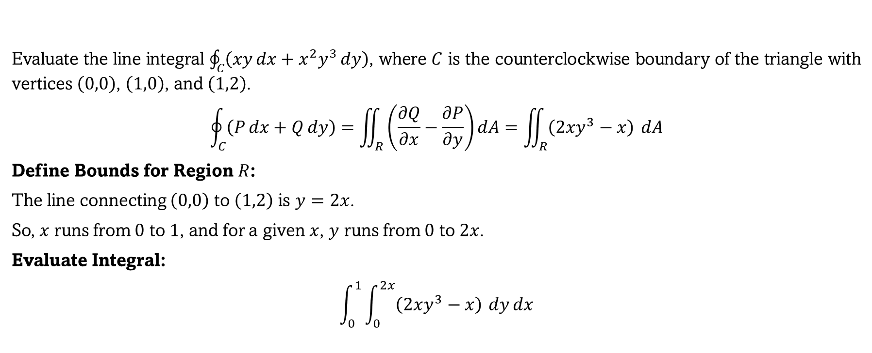
Green’s Theorem
Example 01
Evaluate the line integral $\oint_{C}{\left(xy dx+x^{2}y^{3} dy\right)}$, where $C$ is the counterclockwise boundary of the triangle with vertices $\left(0,0\right)$, $\left(1,0\right)$, and $\left(1,2\right)$.
$$\oint_{C}{\left(P dx+Q dy\right)}=\iint_{R}{\left(\frac{∂Q}{∂x}−\frac{∂P}{∂y}\right)}dA=\iint_{R}{\left(2xy^{3}−x\right)} dA$$
Define Bounds for Region $R$:
The line connecting $\left(0,0\right)$ to $\left(1,2\right)$ is $y=2x$.
So, $x$ runs from $0$ to $1$, and for a given $x$, $y$ runs from $0$ to $2x$.
Evaluate Integral:
$$\int_{0}^{1}{\int_{0}^{2x}{\left(2xy^{3}−x\right)}} dy dx$$

Slide 5

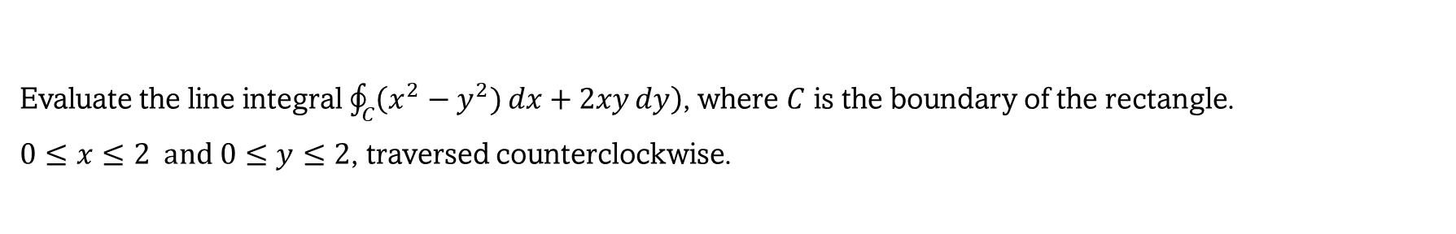
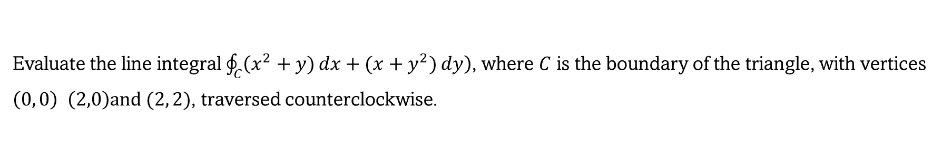
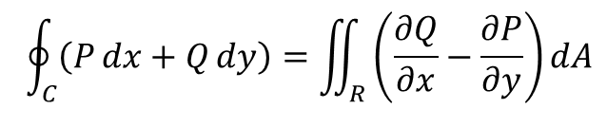
$$\oint_{C}{\left(P dx+Q dy\right)}=\iint_{R}{\left(\frac{∂Q}{∂x}−\frac{∂P}{∂y}\right)}dA$$
Green’s Theorem
Example 02
Evaluate the line integral $\oint_{C}{\left(x^{2}−y^{2}) dx+2xy dy\right)}$, where $C$ is the boundary of the rectangle.
$0≤x≤2 and 0≤y≤2$, traversed counterclockwise.
Example 03
Evaluate the line integral $\oint_{C}{\left(x^{2}+y) dx+(x+y^{2}) dy\right)}$, where $C$ is the boundary of the triangle, with vertices
$\left(0, 0\right) \left(2,0\right)and (2, 2)$, traversed counterclockwise.
The net circulation around any simple closed curve in the region is zero. The field is called irrotational.

Slide 6

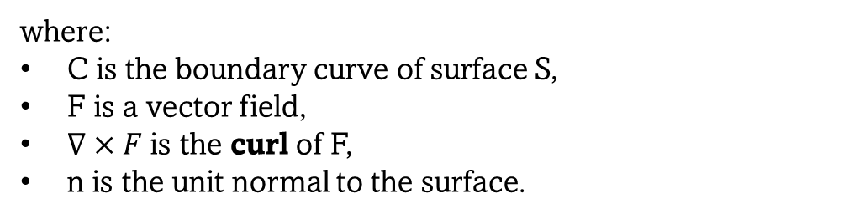
Stokes’ Theorem
Stokes’ theorem states
where:
C is the boundary curve of surface S,
F is a vector field,
$∇×F$is the curl of F,
n is the unit normal to the surface.
So Stokes says: Circulation around the boundary = total curl/rotation inside the surface
Green’s theorem is essentially the two-dimensional version of Stokes’ theorem
Green’s theorem = Stokes’ theorem restricted to a flat surface in the xy- plane
If you add up all the tiny rotations inside a surface, the internal contributions cancel each other, leaving only the circulation around the outside boundary.

Slide 7





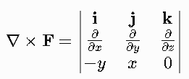

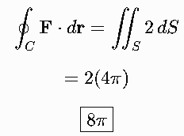

Stokes’ Theorem
Example 01
Evaluate the line integral using Stokes' theorem, where and C is the circle
oriented counterclockwise when viewed from the positive z-axis.
Since S lies in the xy-plane, n = k

Slide 8

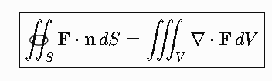

The divergence theorem
The Divergence Theorem connects what happens inside a volume with what crosses its closed boundary.
The divergence theorem states:
The total outward flux through a closed surface equals the total amount of divergence inside the volume.

Slide 9
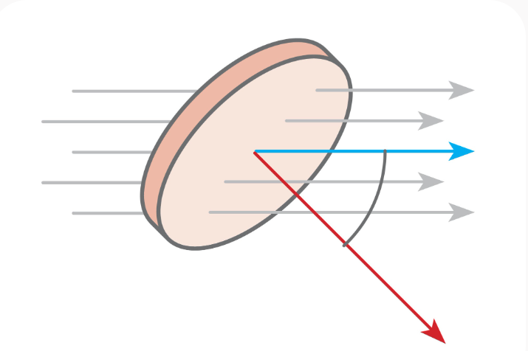
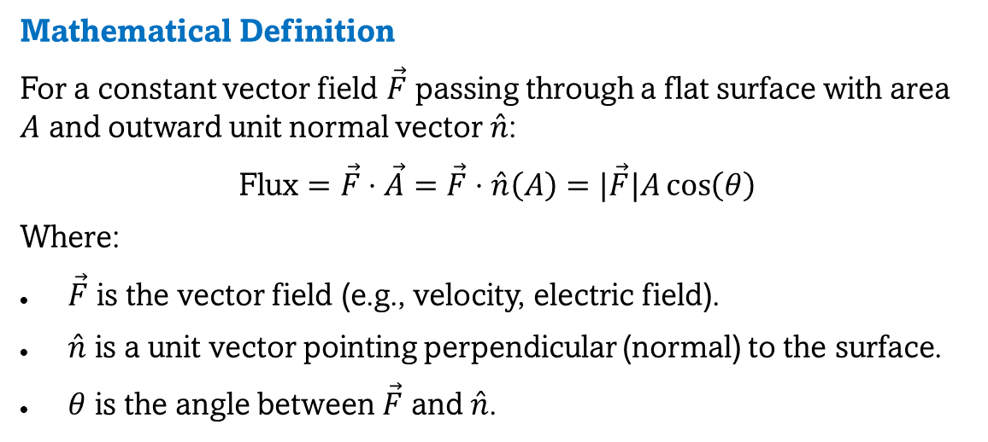
What is Flux?
Intuition
Imagine holding a butterfly net in a flowing river:
Flux measures the net amount of fluid passing through the net per unit time.
If the net is perpendicular to the flow, maximum water passes through.
If the net is parallel to the flow, no water passes through.
If tilted, only the velocity component perpendicular to the net contributes to the flow.
Mathematical Definition
For a constant vector field $\vec{F}$ passing through a flat surface with area $A$ and outward unit normal vector $\overset{ˆ}{n}$:
$$\text{Flux}=\vec{F}⋅\vec{A}=\vec{F}⋅\overset{ˆ}{n}\left(A\right)=|\vec{F}|A\cos\left(θ\right)$$
Where:
$\vec{F}$ is the vector field (e.g., velocity, electric field).
$\overset{ˆ}{n}$ is a unit vector pointing perpendicular (normal) to the surface.
$θ$ is the angle between $\vec{F}$ and $\overset{ˆ}{n}$.

Slide 10
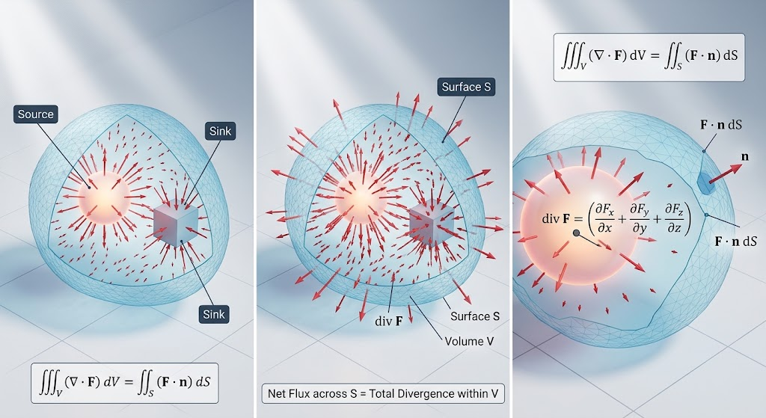
The divergence theorem

Slide 11



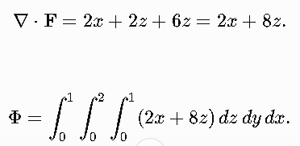
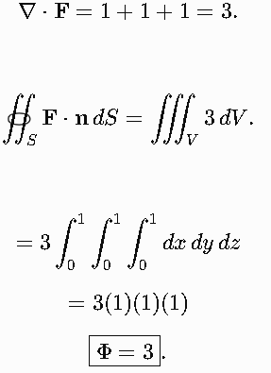

Example 1
Example 2
Evaluate the outward flux of
Find the outward flux of
through the box
through the surface of the cube

Slide 12
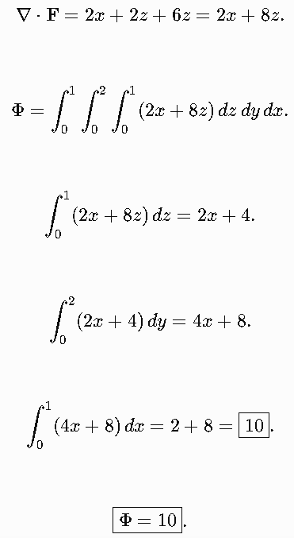

Example 3
Find the outward flux of
through the box

Slide 13
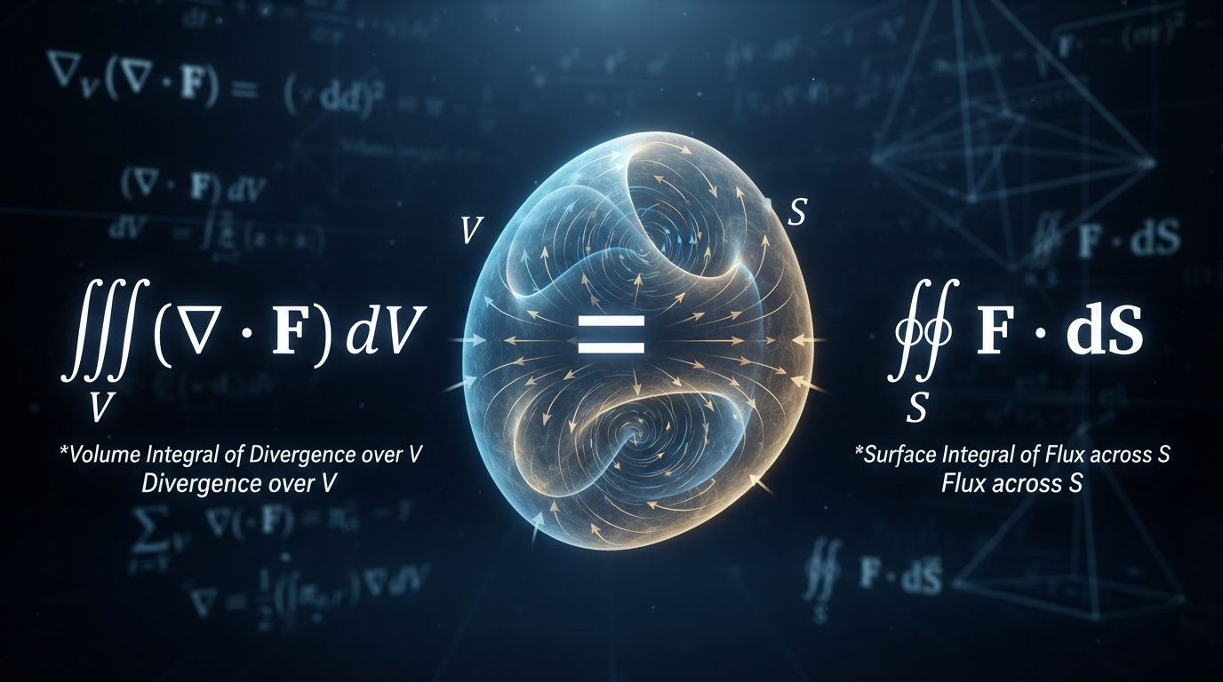
Example 3

